Slide 1
Unemployment Compensation
Pub 4012 – Tab D
Pub 4491 – Lesson 14
Notes:
This presentation is targeted as a Core subject.
Repayment of Unemployment Compensation for prior years is not handled correctly in TaxSlayer. See slide deck 35 Payments, Comprehensive Topic.

Slide 2
Lesson Topics
Unemployment compensation
Defined
Scope limitations
Repayment

Slide 3
Intake Booklet
Review Form 1099-G with taxpayer

Slide 4
Unemployment Compensation
Unemployment compensation includes governmental paid family leave
Received under federal or state laws
State and Federal taxes often withheld
Is it earned or unearned income? (Pub 4012 Tab I-1)
Is it taxable or non-taxable? (Pub 4012 Tab D-1)
Non-taxable at state level in some states
Notes:
Instructor note: Have volunteers review Pub 4012 to determine whether the income is earned/unearned and taxable/non-taxable
Answer: unearned income If a taxpayer does not have their 1099-G, there is a phone number for most states to call where they can find out what they received and their withholding if any. They will need the payer and the payer’s Federal identification number

Slide 5
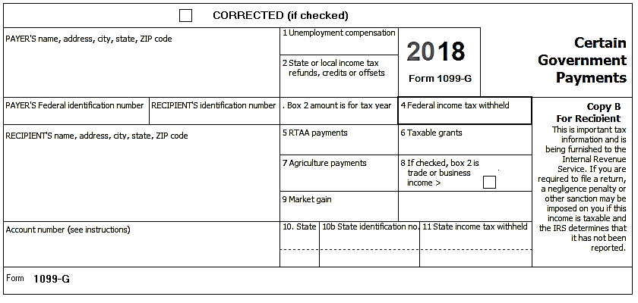
Form 1099-G
Which boxes are out of scope?
Refer to Tax-Aide Scope Manual
Out of Scope
Notes:
Instructor note: Have volunteers review the Tax-Aide Scope Manual. The answer is on the next slide.

Slide 6
Form 1099-G Out of Scope
Boxes 7-9 are out-of-scope
Out of Scope
Out of Scope

Slide 7
Repayment of Unemployment
Repaid current year’s unemployment compensation and not reflected on the Form 1099-G:
Go to Income > Unemployment Compensation > Unemployment Repayment
Repaid prior year’s unemployment compensation
See Payments lesson 35 – comprehensive topic

Slide 8
Unemployment Compensation
Questions?
Comments…

